Slide 1
Virtual Implementation of the 'Data and task Parallelism’ with a multicore-processing unit.
Team Members :
Ridhi Guntur(AP22110011467)
Indu Kukatikonda(AP22110011475)
Roda Chinthapalli(AP22110011496)

Slide 2
Outline Of the Presentation
Problem Statement
Methodology (Algorithm or Flowchart)
Results
Future Work: Scope of Improvement
Conclusion
References

Slide 3
1. Problem Statement
Problem Statement:
With the rise of data-intensive and time-sensitive applications, efficient utilization of multicore processors is crucial. Data Parallelism and Task Parallelism are key strategies for parallel computing, but their effective implementation remains a challenge. This project focuses on simulating and visualizing these parallel computing techniques.
Goal:
To provide a virtual demonstration of Data Parallelism and Task Parallelism using multicore processing, illustrating their benefits in real-world applications.

Slide 4
Objectives:
Implement Data Parallelism for efficient data handling across multiple cores.
Implement Task Parallelism to divide complex tasks into smaller parallelizable units.
Visualize the computational performance improvements using multithreading.

Slide 5
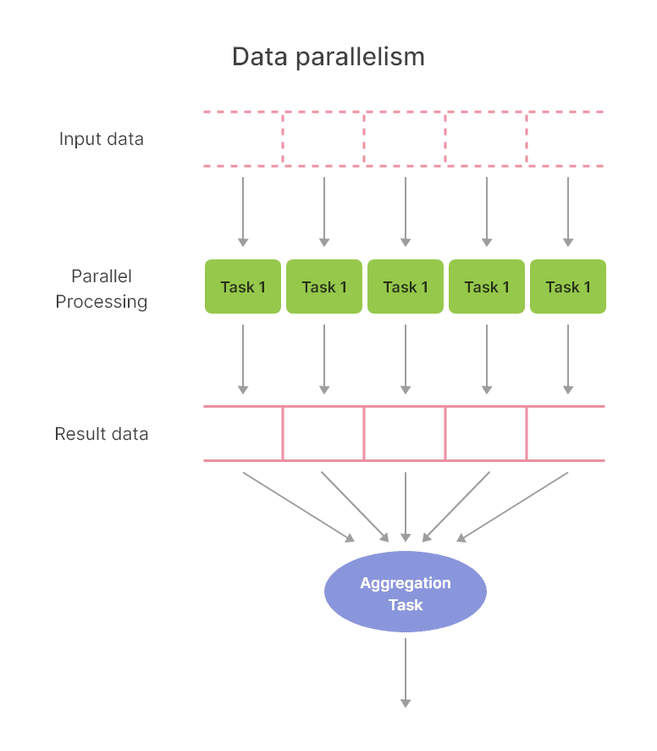
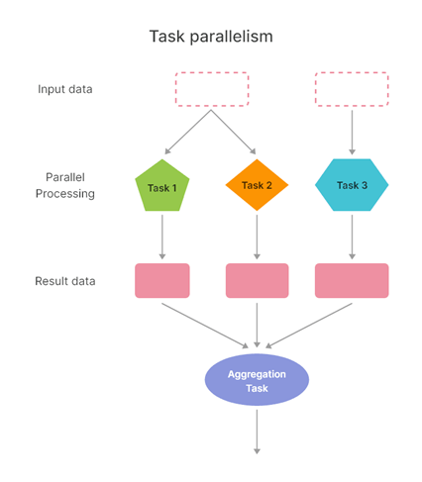
2. KEY IDEAS
DATA PARALLELISM
TASK PARALLELISM
Data parallelism involves splitting the data into smaller chunks and processing them simultaneously across multiple processing units (cores).
Example:
Matrix multiplication
– parallel processing
of rows and columns.
Task parallelism involves dividing the computation into distinct tasks or functions that can run concurrently on different processing units.
Example:
Image processing –
parallel tasks like
resizing, filtering,
and conversion.

Slide 6
3. Methodology
START
Methodology - Data Parallelism
Step 1: Problem Breakdown
The dataset (array) is divided into chunks, each processed by a separate thread.
Each thread calculates a partial sum for its assigned chunk of the array.
Step 2: Thread Creation
The number of threads is specified by the user.
Each thread computes the sum of a specific segment of the array.
Step 3: Synchronization
After all threads complete their task, the results (partial sums) are combined to compute the total sum.
Step 4: Result
Output the total sum of the array after parallel processing.
INPUT DATA
DIVIDE DATA INTO CHUNKS
COMPUTE PARTIAL SUM
THREADS FINISH PROCESSING
COMBINE PARTIAL SUMS
DISPLAY TOTAL SUM

Slide 7
Methodology - Task Parallelism
Step 1: Start Initialize the data and set required parameters like array size and number of threads.
Step 2: Task Division Break the main problem into smaller, independent tasks (e.g., finding sum, max, min, sorting).
Step 3: Thread Assignment Assign each task to a separate thread to enable parallel processing.
Step 4: Parallel Execution Run all threads concurrently to execute the tasks simultaneously.
Step 5: Synchronization Ensure all threads complete their execution before proceeding.
Step 6: Aggregate Results Collect outputs from all threads (e.g., sum, max, min, sorted results) and display.
Step 7: End Conclude the process after successful execution and output aggregation.
START
INPUT DATA
CREATE TASKS (INDEPENDENT TASKS)
CREATE THREADS FOR EACH TASK
WAIT FOR THREADS TO FINISH
EXECUTE TASKS IN PARALLEL
RESULTS

Slide 8
4. RESULTS
Case 1: Data Parallelism (Compute Sum)
Input:
Array Size: (e.g., 10)
Number of Threads: (e.g., 2)
Array Elements: [15, 8, 23, 7, 42, 9, 3, 12, 28, 10]
Execution Steps:
Thread 0: Partial Sum = 53 (Sum of [15, 8, 23, 7, 42])
Thread 1: Partial Sum = 62 (Sum of [9, 3, 12, 28, 10])
Output:
Total Sum: 115
Case 2: Task Parallelism (Multiple Operations)
Input:
Array Size: (e.g., 10)
Array Elements: [15, 8, 23, 7, 42, 9, 3, 12, 28, 10]
Execution Steps & Results:
Compute Total Sum: 115
Find Maximum: 42
Find Minimum: 3
Sort Ascending: [3, 7, 8, 9, 10, 12, 15, 23, 28, 42]
Sort Descending: [42, 28, 23, 15, 12, 10, 9, 8, 7, 3]

Slide 9
5. Future Work (Scope Of Improvement)
Hybrid Parallelism:
Explanation: Combining data parallelism and task parallelism in a single program to leverage the strengths of both approaches.
Optimize for Different Workloads:
Explanation: Different tasks have different needs—some require handling a lot of data (data-intensive) and others need heavy computation (compute-intensive).

Slide 10
6. Conclusion
Demonstrated Parallelism Concepts:
Successfully implemented Data Parallelism to divide tasks across multiple threads and compute partial sums efficiently.
Implemented Task Parallelism to perform multiple independent operations, such as finding the sum, maximum, minimum, and sorting simultaneously.
2. Real-World Applications:
Data Parallelism is widely used in large-scale data processing systems.
Task Parallelism is critical for multi-tasking applications like image processing and simulations.

Slide 11
References
Online resources:
https://www.geeksforgeeks.org/
https://www.tutorialspoint.com/cprogramming/
https://www.stackoverflow.com/
-GitHub Code: https://github.com/Ridhi-215/Data-and-Task-Parallelism

Slide 12
.
-Thank You

